Slide 1
Digital Portfolio
STUDENT NAME: MOHITH KANNA .K
REGISTER NO AND NMID: 212405740/0E179362A85295D95E04626C67EC1108
DEPARTMENT: BCA(BACHELOR OF COMPUTER APPLICATION)
COLLEGE: PERI COLLEGE OF ARTS AND SCIENCE / MADRAS UNIVERSITY

Slide 2
PROJECT TITLE
Digital Portfolio Website (Neon Theme)

Slide 3


AGENDA
Problem Statement
Project Overview
End Users
Tools and Technologies
Portfolio design and Layout
Features and Functionality
Results and Screenshots
Conclusion
Github Link
3/21/2024 Annual Review

Slide 4

PROBLEM STATEMENT
•Many students/job seekers do not have a centralized and attractive way to showcase their skills. •Resumes are static and lack interactivity. •Recruiters prefer a quick, accessible online portfolio.

Slide 5

PROJECT OVERVIEW
•A personal digital portfolio website built with HTML, CSS, and JavaScript. •Responsive design with neon UI theme. •Provides sections for About Me, Skills, Projects, and Contact. •Can be hosted online via GitHub Pages.

Slide 6

WHO ARE THE END USERS?
•Students who want to showcase projects. •Job seekers applying for internships/placements. •Recruiters and interviewers who want a quick view of your skills.

Slide 7

TOOLS AND TECHNIQUES
Frontend: HTML, CSS, JavaScript Styling: Neon theme with CSS Hosting: GitHub Pages Version Control: Git & GitHub

Slide 8
POTFOLIO DESIGN AND LAYOUT
Sections: Home, About, Skills, Projects, Contact Mobile-first design for responsiveness Neon buttons, glowing text, hover animations Clean, modern UI
8

Slide 9
FEATURES AND FUNCTIONALITY
•Interactive navigation menu •Responsive (works on mobile, tablet, desktop) •Project showcase with links •Contact form (basic form or mailto link) •Hosted live via GitHub Pages

Slide 10
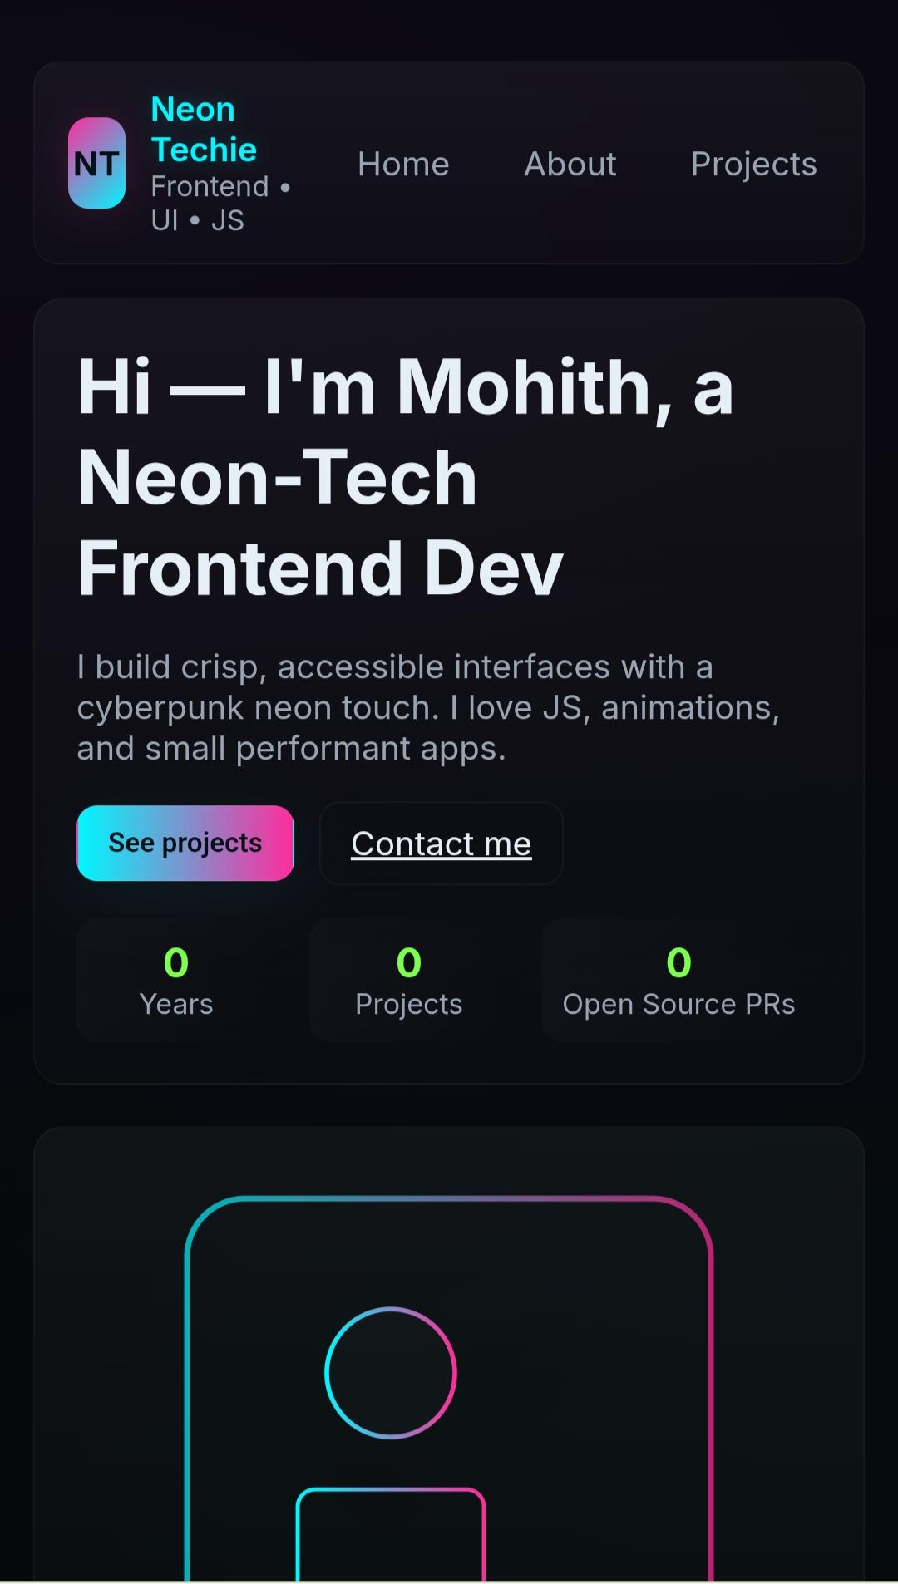
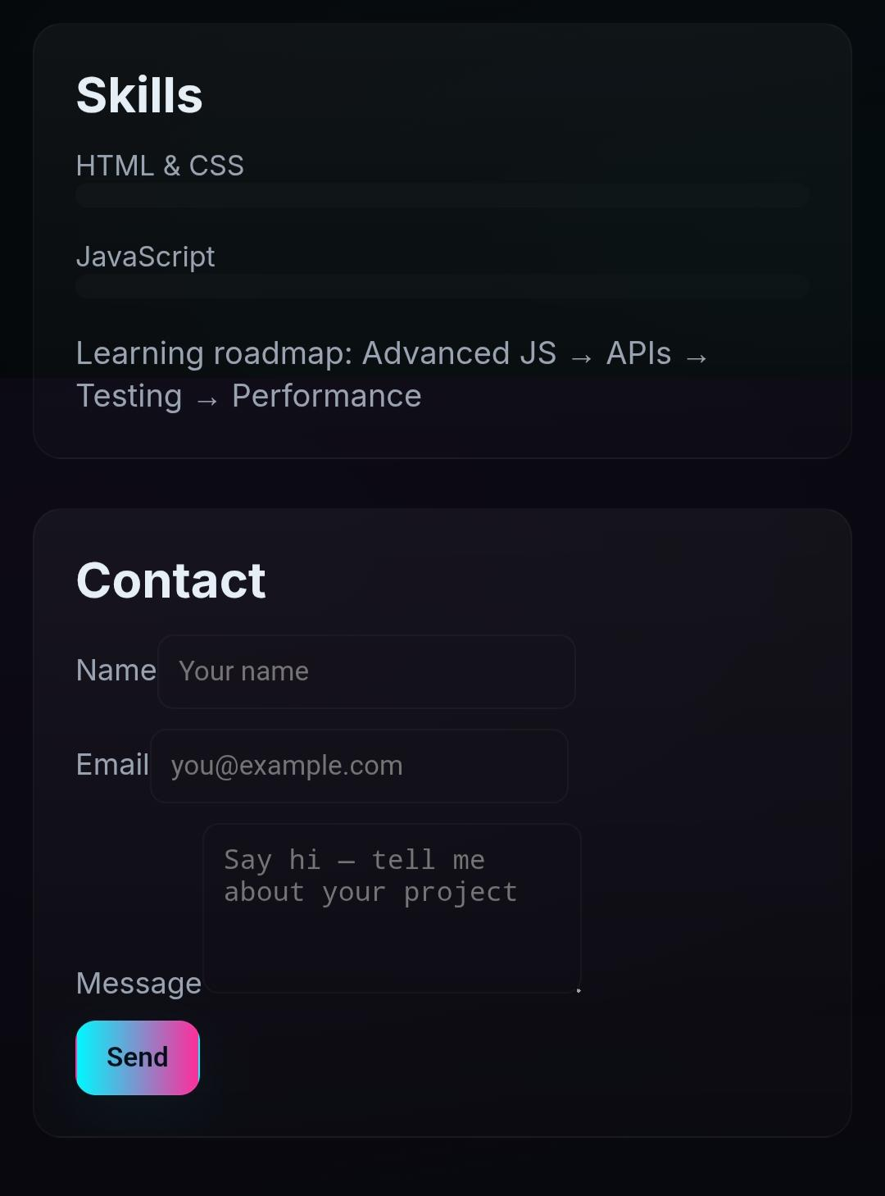
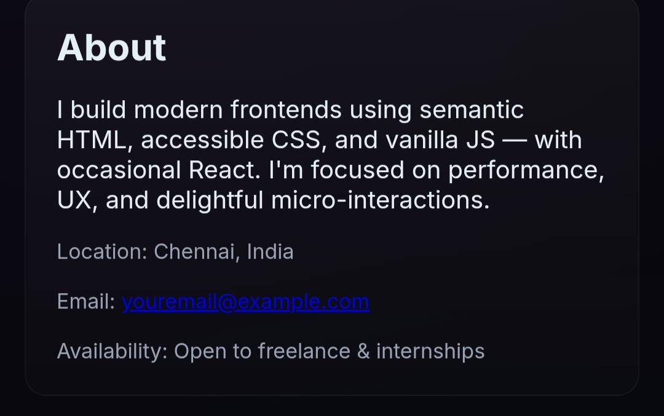

RESULTS AND SCREENSHOTS
Home page
Contact page
About page
3/21/2024 Annual Review
10

Slide 11
CONCLUSION
•Successfully built a personal Digital Portfolio Website. •Neon UI makes it visually appealing. •Easy to update and expand. •Helps in internships/placements by providing recruiters a quick link.
11

